Slide 1

Wired & Wireless Communication

Slide 2
Outline
What is communication?
Bandwidth in communication
Transmission media and its methods
Various wired and wireless applications
Slide <number>

Slide 3
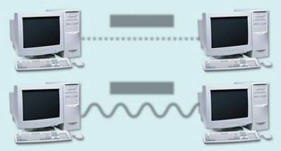
Communication
Communications – sending and receiving messages
Communications channels – paths through which messages are passed
Signals can be:
  Analog – data is in continuous waveforms
  Digital – data is in discontinuous pulses (0’s & 1’s)
  Advantages of Digital signal
      High quality
      Carry much more information
      Easily interpreted by computer
digital
analog
Slide <number>

Slide 4

Bandwidth in communication
Bandwidth – the amount of data that can be transmitted
through a given communications channel
  Analog measured in cycles per second (Hz)
  Digital measured in bits per second (bps)
Slide <number>

Slide 5
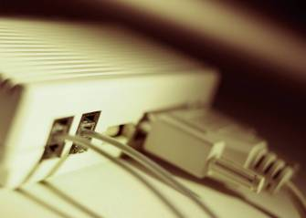
Transmitting data (Broadband and Modems)
Broadband – any transmission medium that transports high volumes of data at high speeds
Modem – Transmit data over telephone lines
  Modulation – converts digital (from computer) to analog to cross telephone lines
  Demodulation – converts analog (phone lines) to digital for computer
Slide <number>

Slide 6
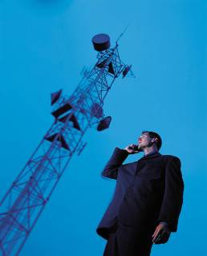
Wireless Transmission Media
Wireless transmission media refers to the methods of carrying data through the air or space using infrared, radio, or microwave signals.
Slide <number>

Slide 7
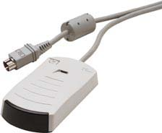
Wireless Transmission Media: Infrared
Infrared is a wireless transmission medium that carries data via light beams.
  Transmitter and receiver must be in line of sight.
  An IrDa port is needed to use infrared with a computer.
Slide <number>

Slide 8
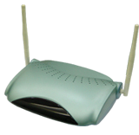
Wireless Transmission Media: Radio
Radio is a wireless transmission medium that carries data via radio frequency signals.
  Wireless LANs in a home or business are one type of radio technology.
  Radio signals can be long range (between cities or regions) and short range (within a building).
  Radio signals are susceptible to noise and electrical interference.
Slide <number>

Slide 9

Wireless Transmission Media: Bluetooth
Bluetooth: Short-range radio transmission technology
  Devices identify each other by
  identification number.
  Connection is confirmed before
  it is made final.
Slide <number>

Slide 10

Wireless Transmission Media: Microwaves
Microwaves are high-frequency radio waves
  Much of long-distance telephone service is carried by microwaves.
  Microwaves travel in a straight line.
  Microwave relay stations are built about 30 miles apart.
Slide <number>

Slide 11
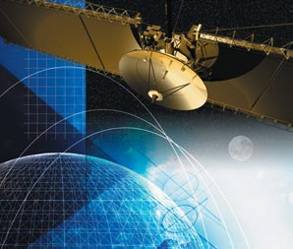
Wireless Transmission Media: Satellites
Satellites are microwave relay stations suspended in space. They use microwave signals to transmit data to and from earth-based microwave relay stations.
  They are positioned in geosynchronous orbits.
Slide <number>

Slide 12
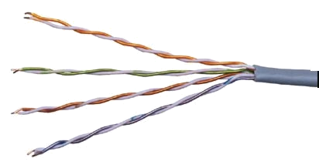
Wired Communication via the PSTN
Wired Transmission Media
The public switched telephone network (PSTN) is the world telephone system.
  It is used for data as well as voice communications.
  Twisted-pair wire and fiber-optic cable provide the connections for the system.
  Home and business phones are connected to subscriber loop carriers (SLCs).
Slide <number>

Slide 13
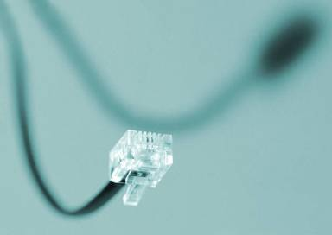
Wired Transmission Media
Wired Communication via the Twisted Pair
Twisted Pair – two insulated wires twisted around each other – used for telephone wires
Slide <number>

Slide 14

Wired Communication via the Coaxial Cable
Wired Transmission Media
Coaxial Cable – center copper wire surrounded by insulation, surrounding a layer of braded wire
Slide <number>

Slide 15

Wired Communication via the Fiber Optic
Wired Transmission Media
Fiber-optic cable – thin strands of glass that carry data by
light pulses
Slide <number>

Slide 16
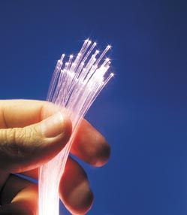
Multiplexing
Multiplexing technology enables simultaneous multi-use of transmission lines.
  Copper wire allows up to 24 simultaneous calls per wire.
  Fiber-optic cable permits up to 43,384 calls per strand.
Slide <number>

Slide 17

Cellular Telephones
Cellular telephones enable calls to be placed through a wireless telecommunications system.
  Cellular phones use radio or infrared signals.
  Cells are limited geographic transmission areas.
A mobile telephone switching office (MTSO) monitors the signal strength of cellular phones.
Slide <number>

Slide 18
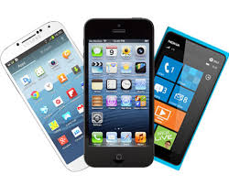
Personal Communication Service (PCS)
Personal Communication Service (PCS) refers to digital cellular telephone service technologies.
Digital cellular phones offer:
  Noise-free sound
  Improved coverage
  Protection from eavesdropping and phone fraud
  Voice recognition
  High-speed Internet access
Slide <number>

Slide 19

Wired and Wireless Applications
Internet telephone – using the Internet for real-time voice communications
Slide <number>

Slide 20

Wired and Wireless Applications
Videoconferencing – using sound and video technologies to meet with others
Slide <number>

Slide 21
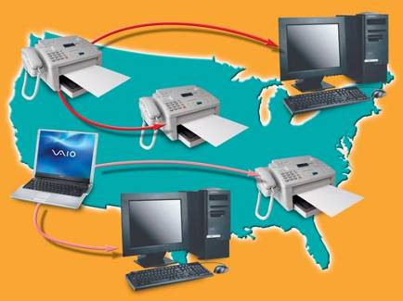
Facsimile (Fax) Transmission
Fax transmission is the means of sending an image of a document over telephone lines.
Slide <number>

Slide 22
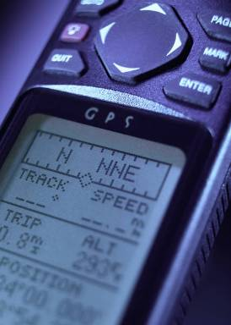
Satellite Radio, GPS
Satellite radio - broadcasts are transmitted through a satellite
GPS – global positioning systems
  27 earth orbiting satellites
  Used in navigation systems
Slide <number>

